Slide 1

CCOB Excel Workshop
September - 2019

Slide 2
We spend a lot of our lives in Excel
Excelwithbusiness.com Blog
“One study estimates that 81% of businesses globally use Excel.
“A survey of several hundred knowledge workers indicated that we spend more than 10% of our working lives in spreadsheeting and for those working in research and development or finance, it’s more like 30% or 2.5 hours a day, almost as much time as we spend on the toilet and more than exercising.”
“What if you optimized your Excel performance? What impact would that have over a year – an entire career?”
September - 2019

Slide 3
Your Excel skills could land you your next job
Fortune.com
“High proficiency in software like Microsoft Excel is increasingly helping people land jobs, the Wall Street Journal reports based on data from career analysis firm Burning Glass Technologies.”
The study found that 78% of these jobs require digital skills like Excel and word processing.
“Effectively, entire segments of the U.S. economy are off-limits to people who don’t have basic digital skills,” the report notes.
September - 2019

Slide 4
Did you know that learning Microsoft Excel will earn you a higher wage?
Royalwise.com
“It’s true! As reported by this Huffington Post article, a recent analysis of the labor market showed that knowing Microsoft Excel is key to making more money, even if you work in customer service jobs such as retail.”
Positions that require basic digital skills tend to pay 13% more than jobs that require no digital proficiency.
September - 2019

Slide 5
Excel skills employers look for
Basic Skills
Advanced Skills
Basic Navigation
Formatting
Sorting
Filter
Data validation
Data protection
Find & Replace
Named range
Formulas
Concatenation
Trim
Pivot Tables
SUMIF/SUMIFS
COUNTIF / COUNTIFS
VLOOKUP
IF Function
IFERROR
Conditional Formatting
Index + Match
Charts & Analysis
Multiple linked Excel Worksheets
September - 2019

Slide 6
Game of Thrones
Data Visualization:
Game of Thrones Character Deaths
Source Data: Github
https://github.com/Vinceno32/Excel-Workshop-Treasure-Trove
Fields:
Order
Season
Episode
Character Killed
Allegiance (Tiered)
Killer
Method
Method Category
Reason
Location
Importance
- > 2 Allegiances
What do we want to know?
September - 2019

Slide 7
Remember: Guiding Principles
A tool is just that!
You shouldn’t have to pay for “Excel Tips”
Leverage official Microsoft Forums
Define your Use Case before diving in
You’re use case isn’t unique
Focus on mastering specific functions one at a time
Tell a Story with the PivotTables/Charts
“Storytelling with Data” – Cole N. Knaflic
September - 2019

Slide 8
Excel Resource and Public Data Repositories
Official Microsoft Support Resource
World Bank Data | World Health Organization
Google Public Datasets (Only works in Chrome browser)
EU Data
FiveThirtyEight (Most User Friendly, Best data to Tell a Story!)
Census Data | Data.Gov
September - 2019

Slide 9
Excel Workshop Schedule
January 22, 2020 –
Introduction to workshops
February 05, 2020 –
Basic Navigation, Formatting, Data Clean Up, Sorting, Filters February 19, 2020 –
VLOOKUP, Conditional Formatting
March 04, 2020 –
Sum, Count, Average, Subtotal, SumIF, CountIF, SumIFS, CountIFS
March 18, 2020 – Spring Break No Session.
April 01, 2020 –
If Functions
April 15, 2020
Pivot Tables
September - 2019

Slide 10
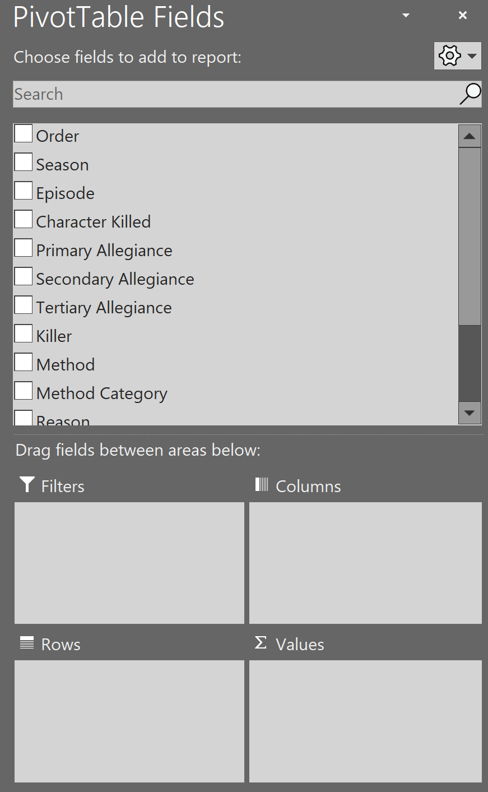
Anatomy of a PivotTable
Data Fields: Labeled fields from the data source (Usually in the first row of the source data)
Rows: Distinct groups/categories to summarize data on
Columns: Ideal for “over time” data fields but can also be used to cross-tabulate categorical data
Values: Fields that can be “calculated” - usually Numeric – using an aggregate function (Sum, Average, Max, Min, Count)
Filters: Focus the data on specific critera (ex. “Show Only Season 1”)
September - 2019

Slide 11

Questions
September - 2019

